Slide 1
21th National Convention on Knowledge, Library and Information Networking (NACLIN 2018) In collaboration with GITAM Deemed to be University, Visakhapatnam October 4-6, 2018 @ GITAM, Visakhapatnam
Innovative Library Services
&
Management of Public Libraries

Slide 2
The Management of Change In Libraries
Is an important and necessary factor for their survival in today’s uncertain environment.
The waves changes that are evident in the journey from the agrarian society to post-industrial society into the appropriate context of scientific perspective.
Libraries need a management strategy that views libraries as a potential source for competitive advantage.

Slide 3
There Is Nothing Permanent Except Change - Characteristics
We cannot think of anything of the universe to last.
If change is of the essence of existence one would have thought it only sensible to make it the premise of our way of thinking.
Change is endemic.
It is rapid, and often has significant implications.

Slide 4
There Is Nothing Permanent Except Change - Characteristics
Everyone finds change difficult.
Change is not made without inconvenience, even from worse to better.
Throughout the last hundred years academics and practitioners have developed a very extensive body of literature on the theory and practice of change management including the development of a wide range of concepts, models, tools and techniques.

Slide 5
There Is Nothing Permanent Except Change - Characteristics
Change has a considerable psychological impact on the human mind.
To the fearful it is threatening because it means that things may get worse.
To the hopeful it is encouraging because things may get better.
To the confident it is inspiring because the challenge exists to make things better.
Thus managing change appears to be tough, there is little agreement on what factors most influence transformation initiatives.

Slide 6
Change Management: The Concept
There is an extensive and complex literature on the management of change.
Change management has been approached from a variety of different angles and applied to numerous organisational processes.
Change by definition requires creating a new system.
Managing change therefore requires managers to think about the organization from a new perspective.

Slide 7
Change Management: The Concept
By consolidating the different definitions of change management as evident in the literature (Burnes, 2000; Patton and McCalman, 2000), change management refers to.
The task of ongoing change, i.e. the task of managing change in a systematic manner with the aim of implementing new methods and systems in an ongoing organization along with managing its impact on people more effectively.

Slide 8
Change Management: The Concept
An area of professional practice, i.e. many consultants is engaged to help clients manage the changes they faces.
A body of knowledge consisting of models, methods, techniques, and other tools that are drawn from psychology, sociology, business administration, economics, industrial engineering, systems engineering and the study of human and organizational behaviour.
A control mechanism consisting of requirements, standards, processes and procedures

Slide 9
Change Management In: Library And Information Centres
Change is no more a matter of choice, it has now become imperative on the part of the libraries and information centres to achieve some major changes to increase the flexibility, the quality and the efficiency of the services they offered.
The role of libraries has gradually changed from the traditional storehouse of information to access providers.
There has been a paradigm shift in the ways libraries used to be managed.

Slide 10
Change Management In: Library And Information Centres
The problems associated with the transition in the case of libraries have both content and a process dimension.
The tools and techniques that were suitable for traditional documents don’t hold good for present-day documents due to changes in technology, new information format, and users’ requirements.
So, a whole new approach needs to be developed to handle the situation.

Slide 11
From System’s Point of View
Any change to one part of the library will have an impact on all the other parts due to the fact that the library is considered as the interconnected sub-systems of its different sections and processes and in turn has an effect on its performance.
The library is open to – and interacts with – the external environment as well as being open internally to the other sub-systems in the organisation.

Slide 12
From System’s Point of View
The objective of this approach is to structure the functions of the library in a manner that clearly defines lines of co-ordination and interdependence emphasising achieving synergy rather than optimising performance of any one individual part.
Implementing changes should be based on such structure of the functions of the libraries (Kathleen et al., 2003).

Slide 13

RAJA RAMMOHUN ROY LIBRARY FOUNDATION
The Pathfinder of Change in Public Library Development
A journey towards enrichment of society

Slide 14

RAJA RAMMOHUN ROY LIBRARY FOUNDATION - The Genesis
Establishment of RRRLF
Raja Rammohun Roy Library Foundation was setup in May 22nd 1972 by the Department of Culture, Government of India
Raja Rammohun Roy Library Foundation is an autonomous organization, fully financed by the Ministry of Culture, Government of India
14
Notes:
14

Slide 15
RAJA RAMMOHUN ROY LIBRARY FOUNDATION - The Objectives
To promote library system and services in India in collaboration with the State Governments, Union Territory Administrations
To functions as a national agency for coordinating, monitoring and developing public library System & Services in the country
To enunciate a national library policy and to help build up a national library system
To provide financial and technical assistance to libraries
To provide financial assistance to organizations, regional or national engaged in the promotion of library development
To promote research on library development
To advise the Government on all matters pertaining to the library development in the country
To propagate the adoption of library legislation in the country
Knowledge for ALL
@ their doorsteps

Slide 16
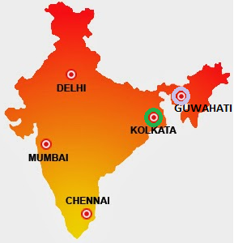
RAJA RAMMOHUN ROY LIBRARY FOUNDATION - The presence

Slide 17
RAJA RAMMOHUN ROY LIBRARY FOUNDATION - Matching Schemes
Developed state (50:50) | Lagging State (60:40) | North East State (90:10)
Assistance towards building up of adequate stock of books and reading materials
Assistance towards development of Rural Book Deposit Centres and Mobile Library Services
Assistance towards Organisation of Seminars, Workshops, Training Courses (Orientation / Refresher), Book Exhibitions and Library Awareness Programmes
Assistance towards purchase of library furniture, storage materials and other items for providing facility to readers
Assistance to Public Libraries towards Increasing Accommodation
Assistance to Public Libraries for Modernization of Library Services
Assistance for engaging Library and Information Science graduates and post-graduates as Intern in Government Public Libraries----New Initiatives

Slide 18
RAJA RAMMOHUN ROY LIBRARY FOUNDATION - non-Matching Schemes- Fully Financed by RRRLF Fund
Assistance towards building up of adequate stock of books through central selection (central book selection)
Assistance to voluntary organisations (NGOs) providing public library services
Assistance for development of RRRLF Knowledge Corner in Public Libraries
Assistance to public libraries towards Celebration of 50/60/75/100/125/150 years and the like
Assistance for organisation of National level Seminar, Workshop, Training and Awareness programme
Assistance for establishment of Digital Information Service Section in Public Libraries
Assistance for Implementation of Swachh Bharat Mission in Public Libraries

Slide 19
RAJA RAMMOHUN ROY LIBRARY FOUNDATION - non-Matching Schemes- Fully Financed by RRRLF Fund
8.Assistance for Children Library and Establishment of RRRLF Children corner
9. Assistance towards Creation of Facilities for Divyang Readers
10.Assistance for Digitization of Copyright Free Manuscripts, Rare Books, Rare Documents, Old Journals, Record of History and Other Materials
11.Assistance for establishment of Digital Information Service Section in Public Libraries
12.Assistance for Implementation of Swachh Bharat Mission in Public Libraries

Slide 20

Activities - Digitization initiatives
20
Notes:
20

Slide 21
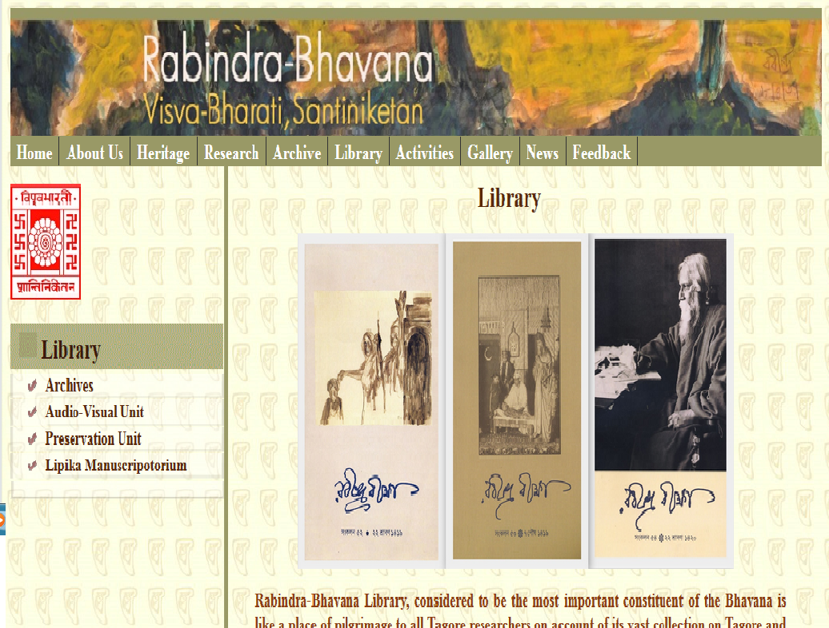
RAJA RAMMOHUN ROY LIBRARY FOUNDATION - Digitization Initiatives
Digitization & microfilming
- Rare collection of Rabindra Bhavan, Visva-Bharati, Shantiniketan
No. of Titles : 11227
(3 million of multilingual pages)
No. of Gramophone Records: 1230
(3333 Bengali songs)
Can be browsed through : http://www.rabindrabhavana.in
Ongoing projects
Digitisation of copyright free rare documents available with Bangiyo Sahitya Parishad, Kolkata

Slide 22

Activities - Research & Publications
22
Notes:
22

Slide 23
RAJA RAMMOHUN ROY LIBRARY FOUNDATION - Research Initiatives
RRRLF Research Project
2011-12 List of Subject Headings for Indian Publications and Documents on India
Dr. E Rama Reddy
2008-09 To promote reading in public libraries
Bengal Library Association
Tagore National Fellow
2010-11 Public library service in Delhi : present status and development plan 2010-20 with greater emphasis on the development of a model public library system for the whole country
Professor P B Mangla
2003-04 A survey of readership in public libraries in Sikkim with recommendation for development
Dr. Soumitra Sarkar
Tagore National Scholar
2012-13 Public Library Reading Habits and Socio Cultural Change: A study of West Bengal, Assam, Tripura and Mizoram
Professor Partha Chatterjee

Slide 24
RAJA RAMMOHUN ROY LIBRARY FOUNDATION - Publications Initiatives
Name of the titles | Author / Editor | Publisher | Year
Online Directory of Public Libraries ( E Publication) | RRRLF | RRRLF | 2015
Tagore Bibliography ( E Publication) | RRRLF | RRRLF | 2012
Public Library System in India | Dr. V. Venkatappaiah | RRRLF | 2010
Granthana : Indian Journal of Library Studies | Director, RRRLF | RRRLF | 1990-2010
RRRLF Newsletter | Director, RRRLF | RRRLF | 1981-2007
Annual Report | Director, RRRLF | RRRLF | 1973-2014
Two decades of the foundation (1972-92) : souvenir on the occasion of the 20th celebrations | Director, RRRLF | RRRLF | 1993
Raja Rammohun Roy and the new learning : Raja Rammohun Roy memorial lectures | Dr. B.P.Barua, editor | Orient Longman | 1988
Directory of Indian Public Libraries | Dr. B.P.Barua, editor | Naya Prokaksh | 1986
Indian libraries : trends and perspectives | Edited by K.M. George | Orient Longman | 1985
National policy on library and information systems and services for India : perspectives and projections | Dr. B.P.Barua, editor | Popular Prakashan | 1985
A decade of the foundation (1972-82) : souvenir of the decennary celebration | Director, RRRLF | RRRLF | 1983
Books for the Millions at their Doorsteps : Information Manual of RRRLF programmes | Director, RRRLF | RRRLF

Slide 25
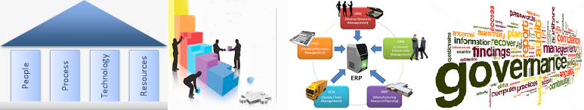
Achievements - Highlights
25
Notes:
25

Slide 26
RAJA RAMMOHUN ROY LIBRARY FOUNDATION - Highlights of Assistance (As on 31st March 2018)
Library Furniture/equipment etc.
- provided to 1619 libraries
- Rs.6.02 (both Central and State share)
Assisted NGO run libraries with Books, Computers, equipment, Library building etc - - provided to 96 libraries
- Amount Rs 106.95 lakhs(Central share only)
Creation of facilities for Divyang readers
- provided to 35 libraries
- Amount Rs. 95.75 lakhs
Women/ Senior Citizen/ Neo Literate/ Career Guidance Section
- established at 72 libraries (Amount Rs. 35.41 lakhs)
Children Corner
54 Libraries (Amount Rs. 54.81 lakhs)
Assisted 13 old reputed libraries - Amount Rs 4.81 lakhs
Establishment of RRRLF Model Library at District Jail of Meerut

Slide 27

New Initiatives
27
Notes:
27

Slide 28
RAJA RAMMOHUN ROY LIBRARY FOUNDATION - New Initiatives
Publication of RRRLF Newsletter on regular basis
New training facility at RRRLF Headquarter
New Assistance schemes introduced for public libraries
Digitization of copyright rare documents
Implementation of Swachh Bharat Mission
Establishment of Digital Information Service Section
Assistance for engaging Library and Information Science graduates and post-graduates as Intern
Go-Live of in-house developed new RRRLF web application on cloud
Online self-driven public library directory
Online Submission of Application under its various non-matching schemes by public libraries and State/UT authorities
Online book submission and tracking of status by Authors/Publishers
Presence in social media
In process of resuming awards for public libraries for innovative services

Slide 29

Future Plans
29
Notes:
29

Slide 30
RAJA RAMMOHUN ROY LIBRARY FOUNDATION - Vision & Goals
India has the largest number of “Public Libraries” (46000+). The development and modernization is a necessity for those citizens who does not have a access to information
Transform the libraries to community information center
All Education / Socio-cultural activities should be linked through “Public Libraries”
Open Universities / Distance learning course / Career guidance materials should be available through Public Libraries
All Government schemes and promotions should be available through Public Libraries. (huge savings in government exchequer)
Realign public libraries with United Nation SDG 2030 goals.

Slide 31
RAJA RAMMOHUN ROY LIBRARY FOUNDATION - Vision & Goals
Short term Goal 3 years 2017-18 to 2019-20
Target : Covering 17,000 libraries every year on an average under all schemes
Medium term Goal 7 years 2017-18 to 2023-24
Target : Covering 19,000 libraries every year on an average under all schemes
Long term Goal 13 years 2017-18 to 2029-30
Target : 20,000 Modern public libraries (community information center)

Slide 32



National Mission on Libraries
Ministry of culture, government of India

Slide 33
National Mission on Libraries - The Background
Sustained development and inclusive growth to the library and information sector of the country in order to transform India into a vibrant knowledge based society the proposal of the National Knowledge Commission (NKC) for setting up of National Mission on Libraries (NML) was approved by the Planning Commission in 2008.
The “Implementation Plan” was prepared after several revisions on the basis of suggestions from the PMO and other authorities.
The Committee of Secretaries (COS) chaired by the Cabinet Secretary at its meeting held on 28th October, 2010 at the Cabinet Secretariat recommended to start the activities prepared under National Commission on Libraries (NCL) in a mission mode.

Slide 34

National Mission on Libraries
NML : Components
National Mission on Libraries formulated the scheme "National Mission on Libraries (NML) - upgradation of libraries providing service to the public". The scheme consists of four components.
Setting up of NML Model Libraries
Quantitative & Qualitative Survey of Libraries
Capacity Building Program
Creation of National Virtual Library of India (NVLI)
RRRLF as Implementing Agency
RRRLF is the nodal agency of NML for administrative, logistics, planning and budgeting purposes and has been entrusted to :
Upgradation of existing libraries and setting up the NML model libraries
Capacity Building Program
Survey of Libraries.

Slide 35
NML Model Libraries - Proposed Activities a& Achievements
Financial Assistance to be provided in favour of State Central Libraries including 9 new and 17 ongoing projects (Rs.874.44 lakh) .
Financial Assistance to be provided in favour of District Libraries including 9 new and 24 ongoing projects (Rs.406.72 lakh).
Financial Assistance to be provided in favour of MoC Libraries including 1 new and 5 ongoing projects (Rs.500.00 lakh).
Financial assistance of Rs.3.00 Lakh to be provided in favour of 115 Govt. District and Divisional Libraries for Development for Networking Infrastructure subject to approval of NKN Connectivity (Rs.345.00 Lakh).
Subscription of E-Journal and E-Book services to be provided in favour of 75 NML Model Libraries (Rs.483.00 Lakh).
Sanction of Assistance and release of payment to the state libraries depends on submission of the proposal and claims respectively from State/UT Library Authority

Slide 36
NML Quantitative & Qualitative Survey - Achievements
Data collected from 5140 libraries and 7120 citizens covering all the states/UT (except Andaman & Nicobar Island and Chhattisgarh).
The work has been completed.
Modified final report as recommended by the Public Library Survey Sub-Committee has been received.
Payment released to IMRB International during 2017-18 : Rs. 33.06 Lakh

Slide 37
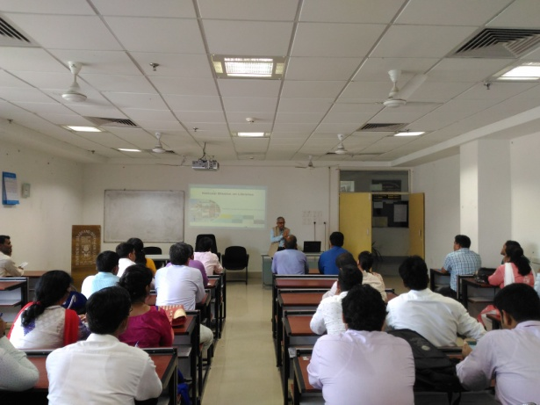
NML Capacity Building Programme - Achievements
14 training programs have been organized in Assam, Delhi, Maharashtra, Odisha, Uttarakhand, Uttar Pradesh, West Bengal, Goa, Pondicherry, Kerala, Tripura.
800+ library personnel have been trained
Expenditure incurred during 2017-18 : Rs. 35.71 Lakh
Library Personnel participated from different states:
Andhra Pradesh, Arunachal Pradesh, Assam, Bihar, Chandigarh, Chhattisgarh, Goa, Haryana, Himachal Pradesh, Madhya Pradesh, Maharashtra, Meghalaya, Nagaland, Odisha, Sikkim, Tamil Nadu, Telengana, Tripura, Uttarakhand, Uttar Pradesh, West Bengal, Rajasthan, Pondicherry, Gujarat, Manipur, Lakshadweep

Slide 38
NML NVLI - Achievements
The National Virtual Library of India (NVLI) has been envisaged as the platform which would bring together all cultural information generated in India and about India and make such information accessible to the citizens through user friendly multilingual search interfaces.
To empower people with right information in order to create a knowledge society and ensure preservation of digital content for the posterity.
IIT Bombay, CDAC, Pune and IGNOU, Delhi entrusted for development of NVLI.

Slide 39

How to Achieve The Desired Goals?

Slide 40
Strategic Change Management
Deals with the major intended and emergent change initiatives taken by the library managers, involving utilization of resources, to enhance the performance of libraries in their external environments.
It is the coordination of interrelated activities of functional areas of a library to achieve an established purpose. Managing change is tough, but part of the problem is that there is little agreement on what factors most influence transformation initiatives.

Slide 41
Strategic Change Management
Change management consists of several critical success factors, which appears to be influenced by two paradigms—Hard factors and Soft factors. Both Hard and Soft factors are complementary to each other.

Slide 42
Hard Factors of Change Management
Hard factors of Change Management are system-oriented and are easier to quantify. There are four key elements of hard factors (Sirkin, Keenan and Jackson, 2005):
Performance Integrity (PI)
Commitment to Change
Effort to Change
Intellectual effort relates to the

Slide 43
Soft Factors of Change Management
Leadership of Change
Team Work
Communication
Motivation
Culture
Attitude towards Change (Personal & Productivity)
Mentality towards Work

Slide 44
Conclusions
Managing Change can be easily installed on the given library or information centre by creating organisational context for change, and it is to be customized by blending “Hard” and “Soft” change strategies to library competencies.
It is sometimes called that the “soft” side of change, managing the people side of a change is often the most challenging and critical component of an organizational transformation.
Soft factors of change have influential bearing on the success of the implementation of change management programme.

Slide 45
Conclusions
Although change in culture and motivation level can be indirectly measured through surveys and interviews, it is difficult to get reliable data on soft factors.
We can say that the effectiveness of soft and hard factors in implementing changes to achieve quality improvement and increased organizational performance are under way but not yet fully coordinated and targeted at the task of implementing changes in the library and information centres.

Slide 46
Conclusions
Whether the influence of hard and soft factors on change management is a new way of implementing the changes in the library and information centres must await the test of time. However, there can be little doubt that the concept has had a significant impact on the thinking of professionals working in a variety of fields.
Changing the management style of the library managers, improving the relationships between the staff and building closer relationships with the library manager may prove to be beneficial in implementing changes in the libraries.

Slide 47
Thank You
Dr. Arun Kumar Chakraborty
Director General, RRRLF & National Library
Addl. Mission Director, NML, Ministry of Culture, Govt. of India
Email: dg-rrrlf@nic.in, Mob: 9433323424
DD-34, Sector-I, Salt Lake, Kolkata 700064

